Slide 1
ENGR5151UG
Computer Vision
Final Project
Spring 2023
Logan McFarland
04-24-2023

Slide 2
My Project

Slide 3
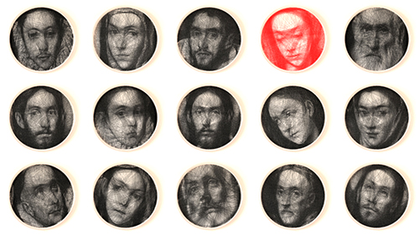
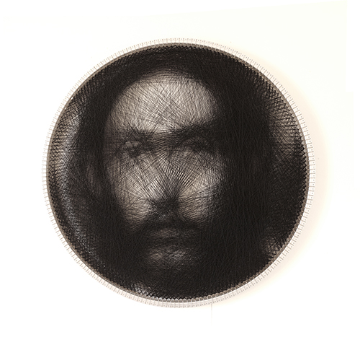
Converting any photo to a drawing
The catch is it will be created using only straight lines
This kind of art is inspired by Petros Vrellis
creates art by knitting
https://www.analysis-consulting.com/single-post/2016/11/22/drawing-with-straight-lines
http://artof01.com/vrellis/works/knit.html

Slide 4
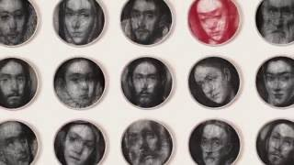

Slide 5
Why?
I am no artist
I’m not an expert
It is fascinating to see that passion
It looked unique
Why not try and use what I’m learning/what I am interested in to achieve a similar result
It became a challenge of sorts
Go a completely different direction but end up with the same result

Slide 6
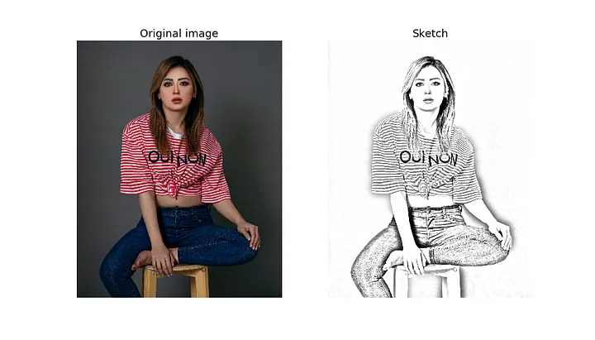
Example of the Easy Way
Convert Image to Grayscale
Invert Image
Apply Gaussian Blur
Invert Blurred Image
Use bitwise division between the grayscale and inverted blurred image
https://towardsdatascience.com/generate-pencil-sketch-from-photo-in-python-7c56802d8acb

Slide 7
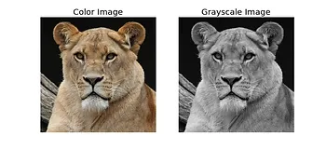
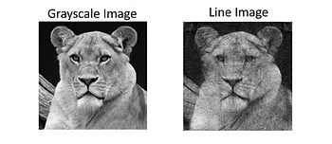
Simplified Process of What I am Doing
Receive an image
Convert it to Grayscale
Recreate Grayscale image using straight white lines on a black background
Unlike this example, I achieved this within a circle to give a similar result as seen in a Petros Vrellis piece
https://www.youtube.com/watch?v=aMXCn1YxZqU

Slide 8
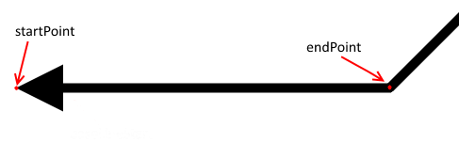
Advanced Process
Select a Start Point on the border of the image
Select an Endpoint on the border of the image
Find the Mean Pixel Intensity (MPI) for a straight line between the Start and End Points
Note : The value of a grayscale pixel is an integer between 0 (black) and 255 (white)
Repeat steps 2 and 3 for all possible Start and End Points
Select the line which contains the lowest MPI.
Subtract a line with a specific grayscale level from the line drawn image
At any point when a value of a pixel is below 0, make it 0
Add a line with a specific grayscale level from the grayscale image.
At any point when a value of a pixel is above 255, make it 255
Repeat from 1st step until the whole image is drawn

Slide 9
How is the Starting Point Obtained?
One of 3 options
Previous endpoint is the next start point
Completely random
Find the start-end pair with the lowest Mean Pixel Intensity
(This is the ideal scenario but it is the most intense by terms of computation)

Slide 10
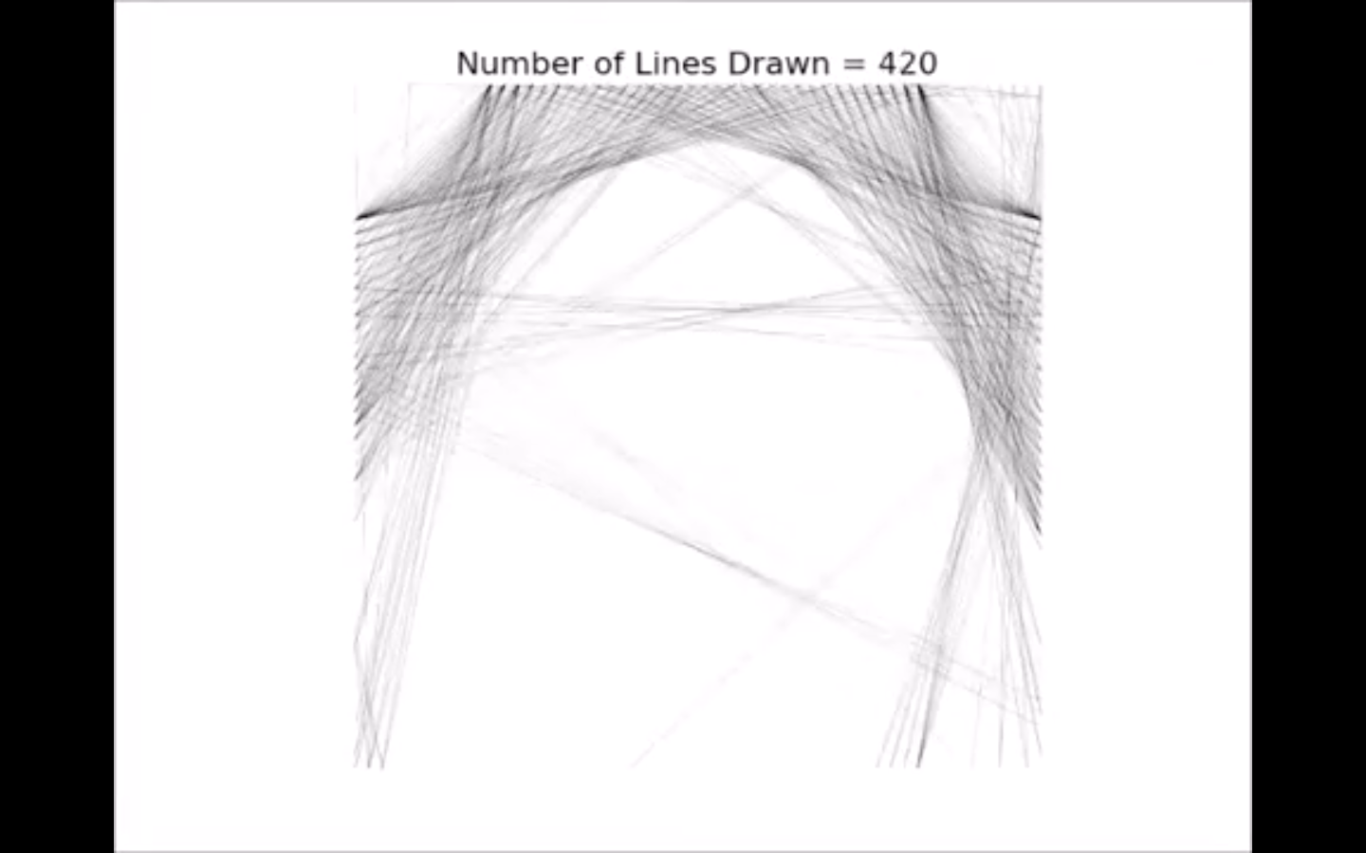
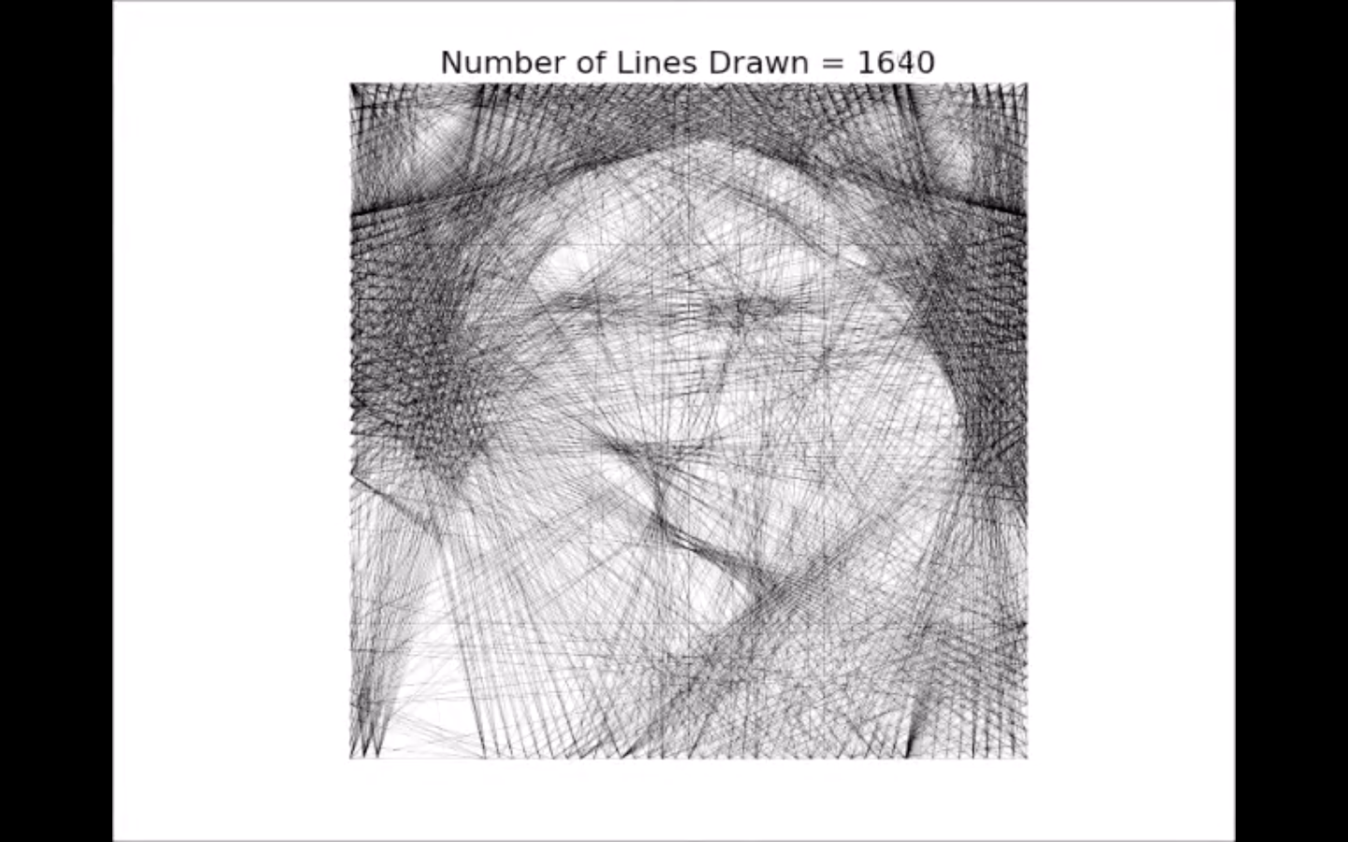
3 Parameters to Consider
How many lines to draw
The Grayscale Levels
The number of Pegs
Pegs are the anchor points at the border of an image where lines will start and/or stop
The higher the number of pegs, the higher the resolution of the picture received
This also increases the number of lines required for the image

Slide 11
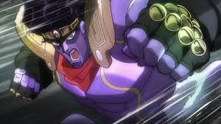
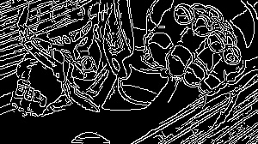
Earlier Results
Before implementation of the Bresenham Algorithm
Using an endpoint to endpoint system
It was cool and worked, but wasn’t what I was going for

Slide 12
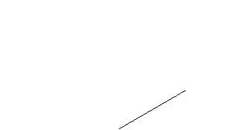
The Failures of Capturing a Frame by Frame Video
With the earlier test, I attempted to make a video displaying a frame by frame build of the “string art”
This was done to see if I could implement it later with the Bresenham Algorithm
It did not work out
I moved on to try and achieve a better string art result before revisiting the video functionality

Slide 13
The Bresenham Algorithm

Slide 14
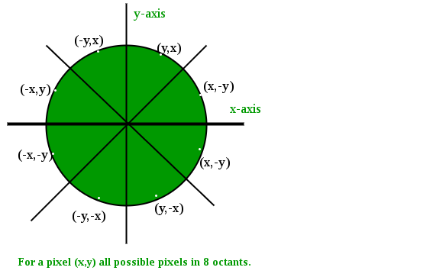
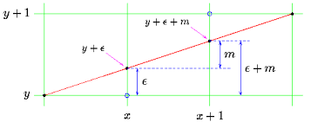
Two Essential Parts
The Bresenham Line Algorithm
a line drawing algorithm that determines the points of an n-dimensional raster that should be selected in order to form a close approximation to a straight line between two points.
The Bresenham Circle Algorithm
a circle drawing algorithm that selects the nearest pixel position to complete the arc
Note -
“Raster images are constructed through pixels. Vector images are constructed through lines, curves, and fills”

Slide 15
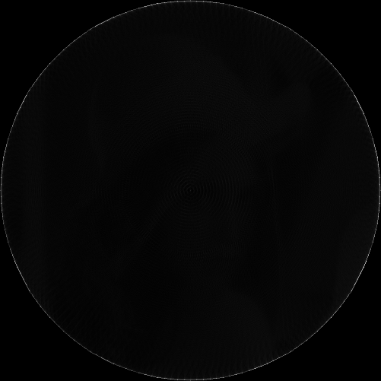
When combined, they create this beautiful circle:

Slide 16
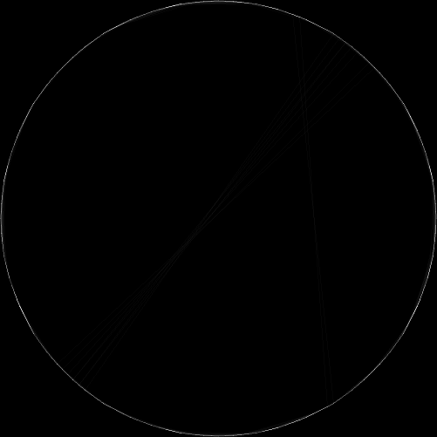
And some lines in the circle…

Slide 17
Results

Slide 18


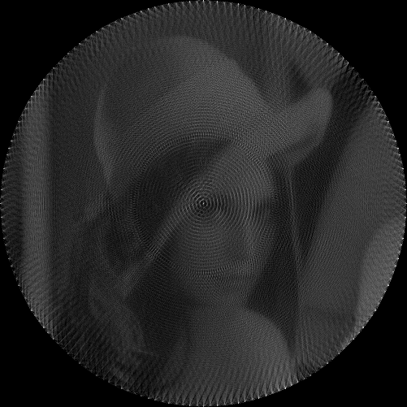
1st - LENNA
A real person

Slide 19
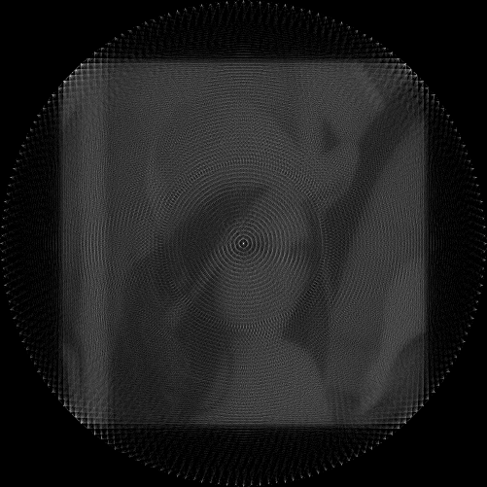
1st - LENNA
A different look

Slide 20
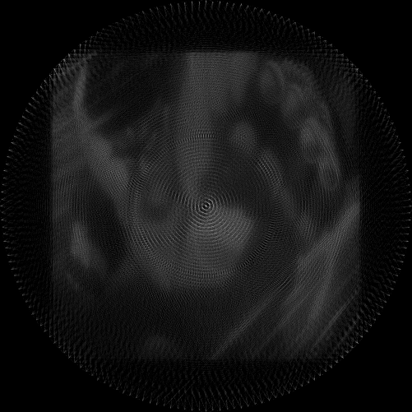
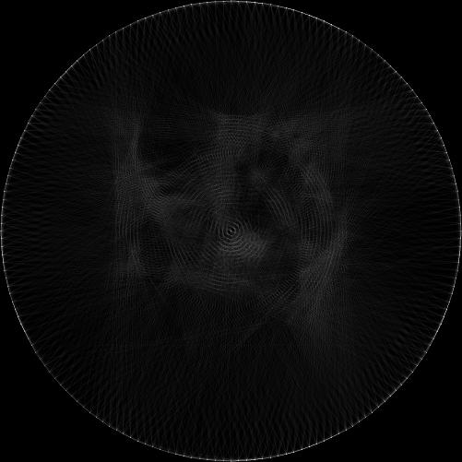
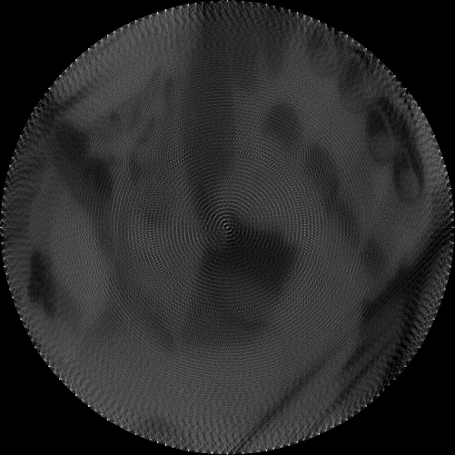
2nd - Star Platinum
An animated character

Slide 21
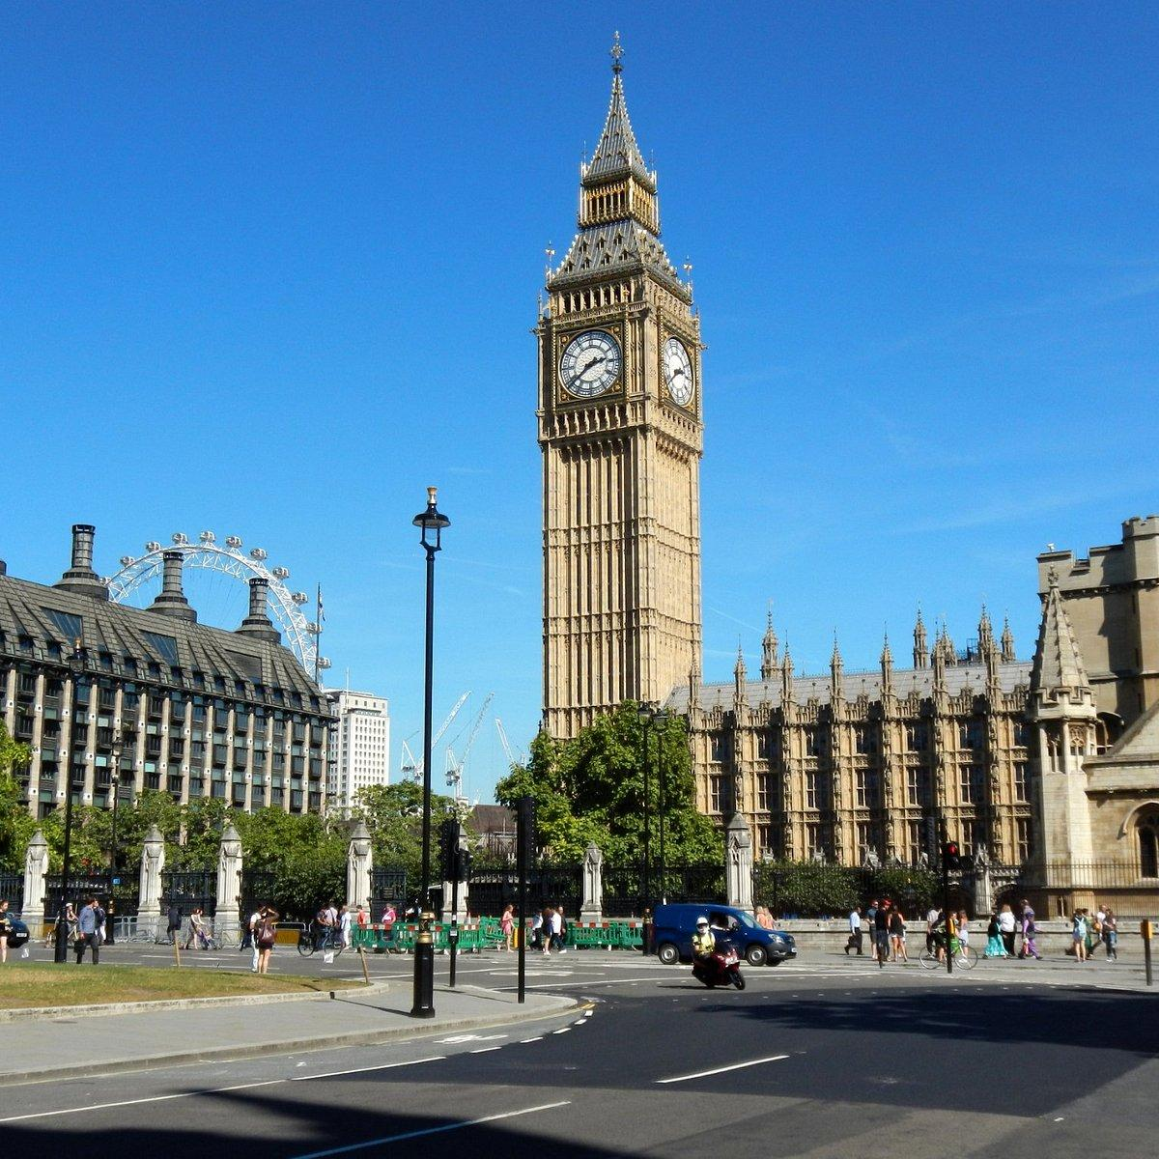
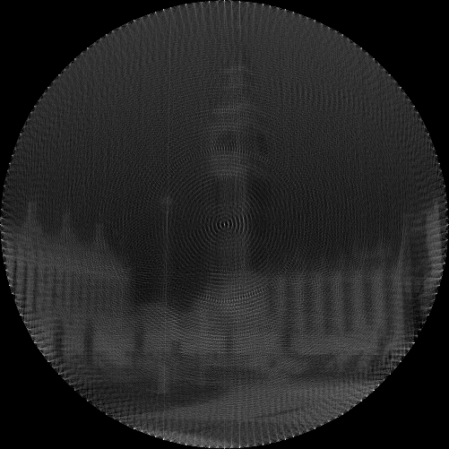
3rd - BIG BEN
A building

Slide 22
Maybe the Best String Art
Result would be from the Whole Picture
A building

Slide 23
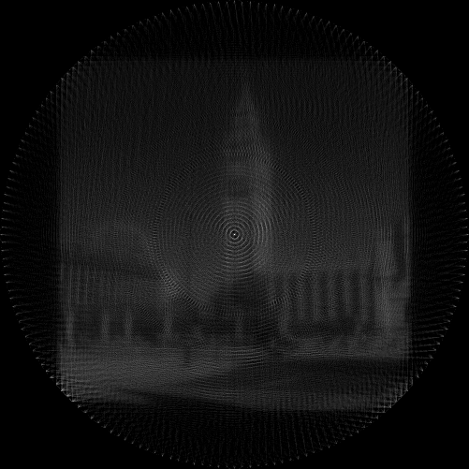
A Different Approach

Slide 24
3rd - BIG BEN
Which is better?

Slide 25
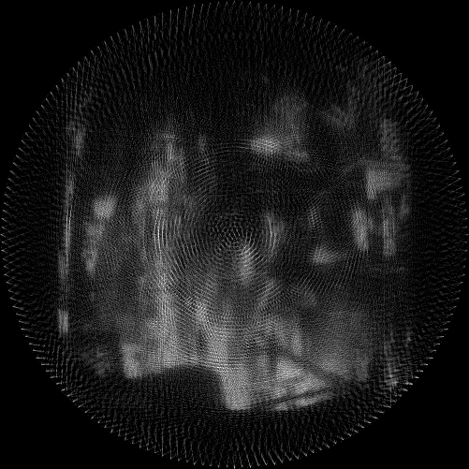
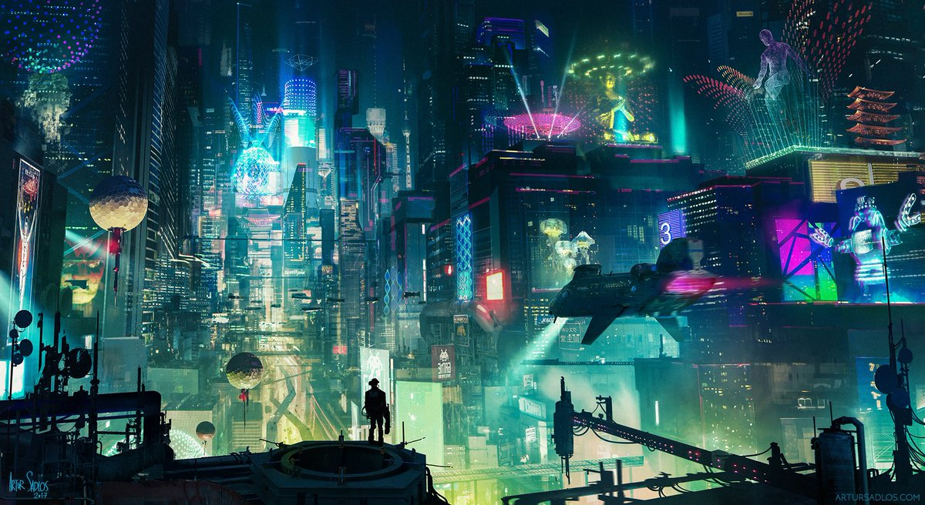
4th - A Cyberpunk City
Test of image size and extreme colors

Slide 26
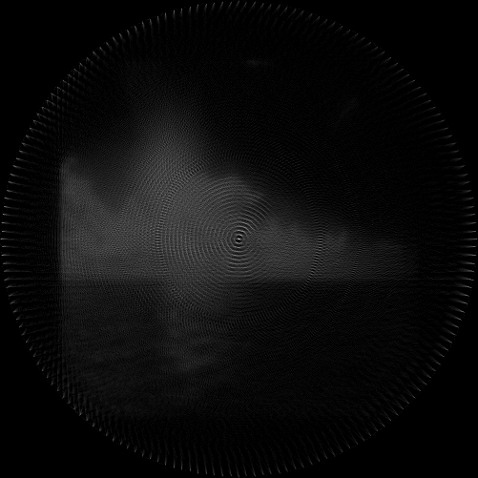
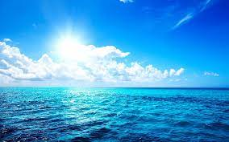
5th - Blue Ocean, Blue Sky, Sunlight
Blue on blue with a unique lighting contrast

Slide 27
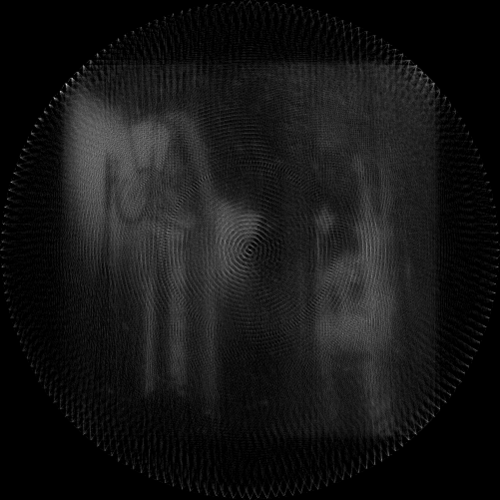
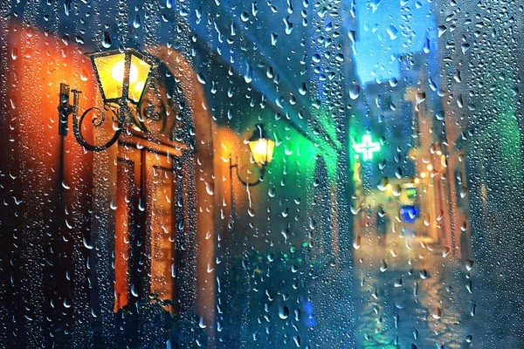
6th - Rain on Lense
Foreground and Background Elements?

Slide 28
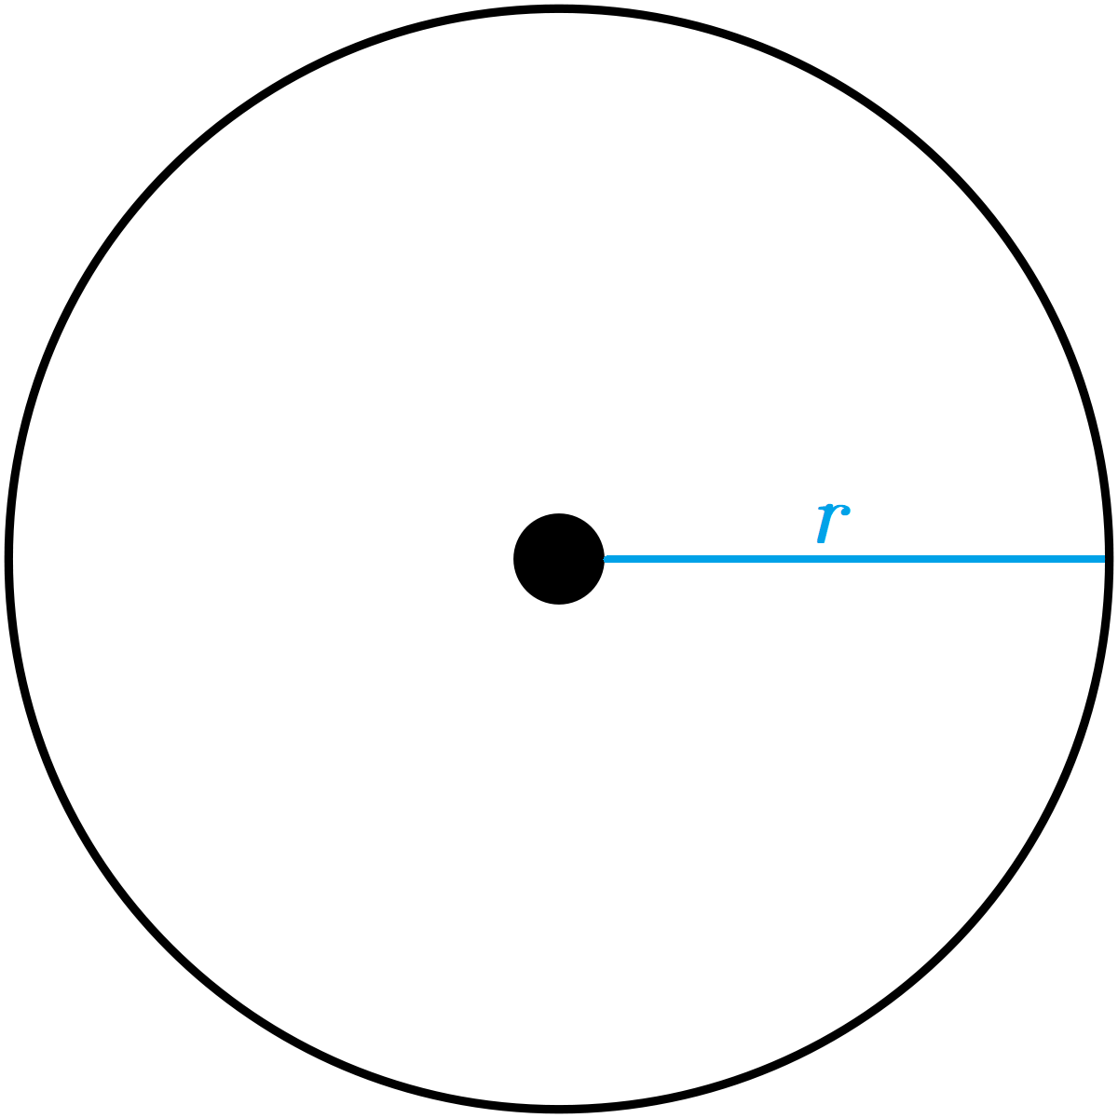
Note
It is interesting to observe how different variables affect the resultant string arts
Image sizes
Radius values
Colors
Lighting
Types of images
Person
Animation
Building
etc

Slide 29
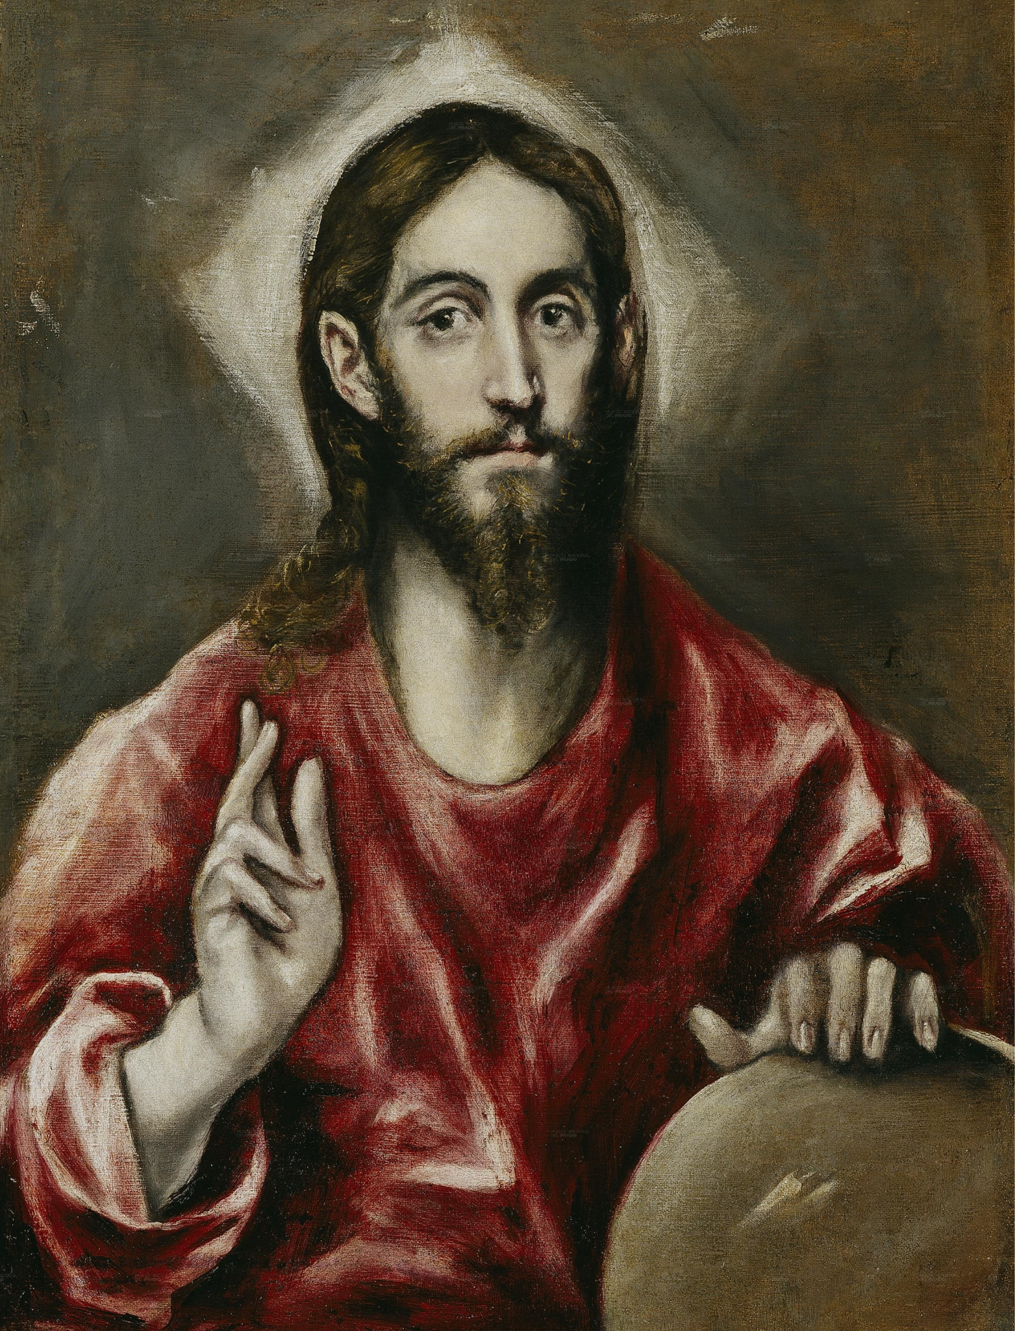
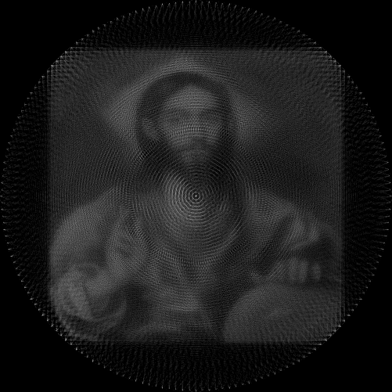
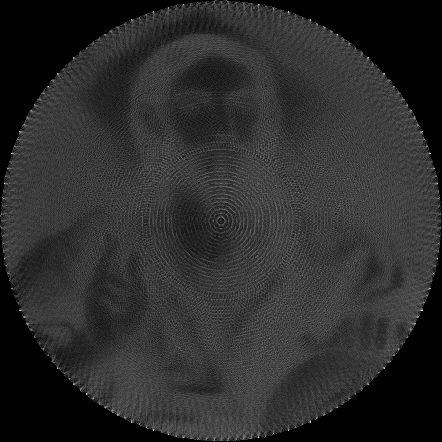
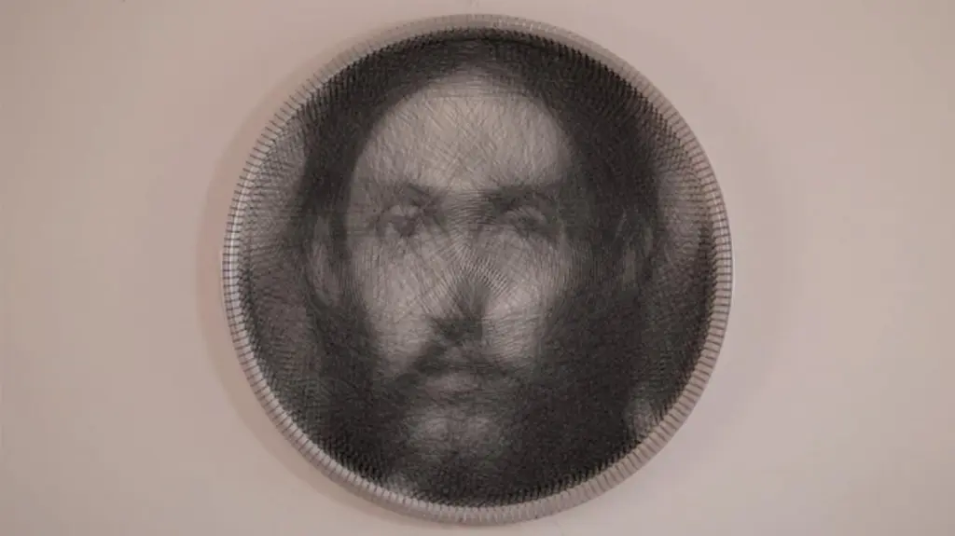
My Creation vs The Original
“The Savior” - El Greco

Slide 30
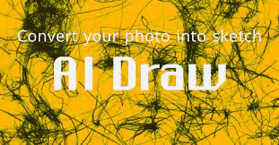
If I Were to Continue…
Refine the reconstruction part of my code to have the image look as good when it is cropped to fit the circle
Create a video showing a frame by frame creation of the string art
Make it accessible
Like the website that inspired this
allow anyone to convert any image and
show them the process of its creation
let them save it

Slide 31
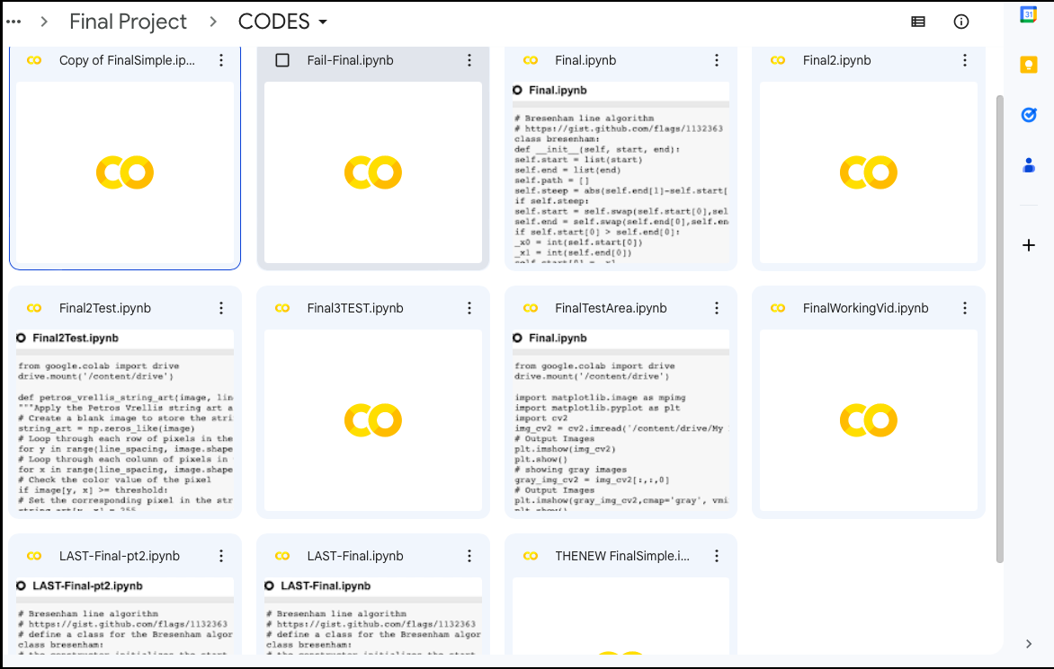
The Junkyard

Slide 32
References
https://www.analysis-consulting.com/single-post/2016/11/22/drawing-with-straight-lines
https://www.robertoreif.com/blog/2018/1/7/drawing-with-straight-lines
https://ai-draw.tokyo/en/
https://en.wikipedia.org/wiki/Bresenham%27s_line_algorithm
https://towardsdatascience.com/generate-pencil-sketch-from-photo-in-python-7c56802d8acb
http://artof01.com/vrellis/works/knit.html
https://www.analysis-consulting.com/single-post/2016/11/22/drawing-with-straight-lines
https://twitter.com/flerlagekr/status/928224004611170304
https://www.flerlagetwins.com/2017/11/loom-art-in-tableau_92.html
https://github.com/danielvarga/string-art
Huge thanks to Daniel Varga on github
Helped with providing the Bresenham line and circle algorithm as well as how to use it successfully

Slide 33
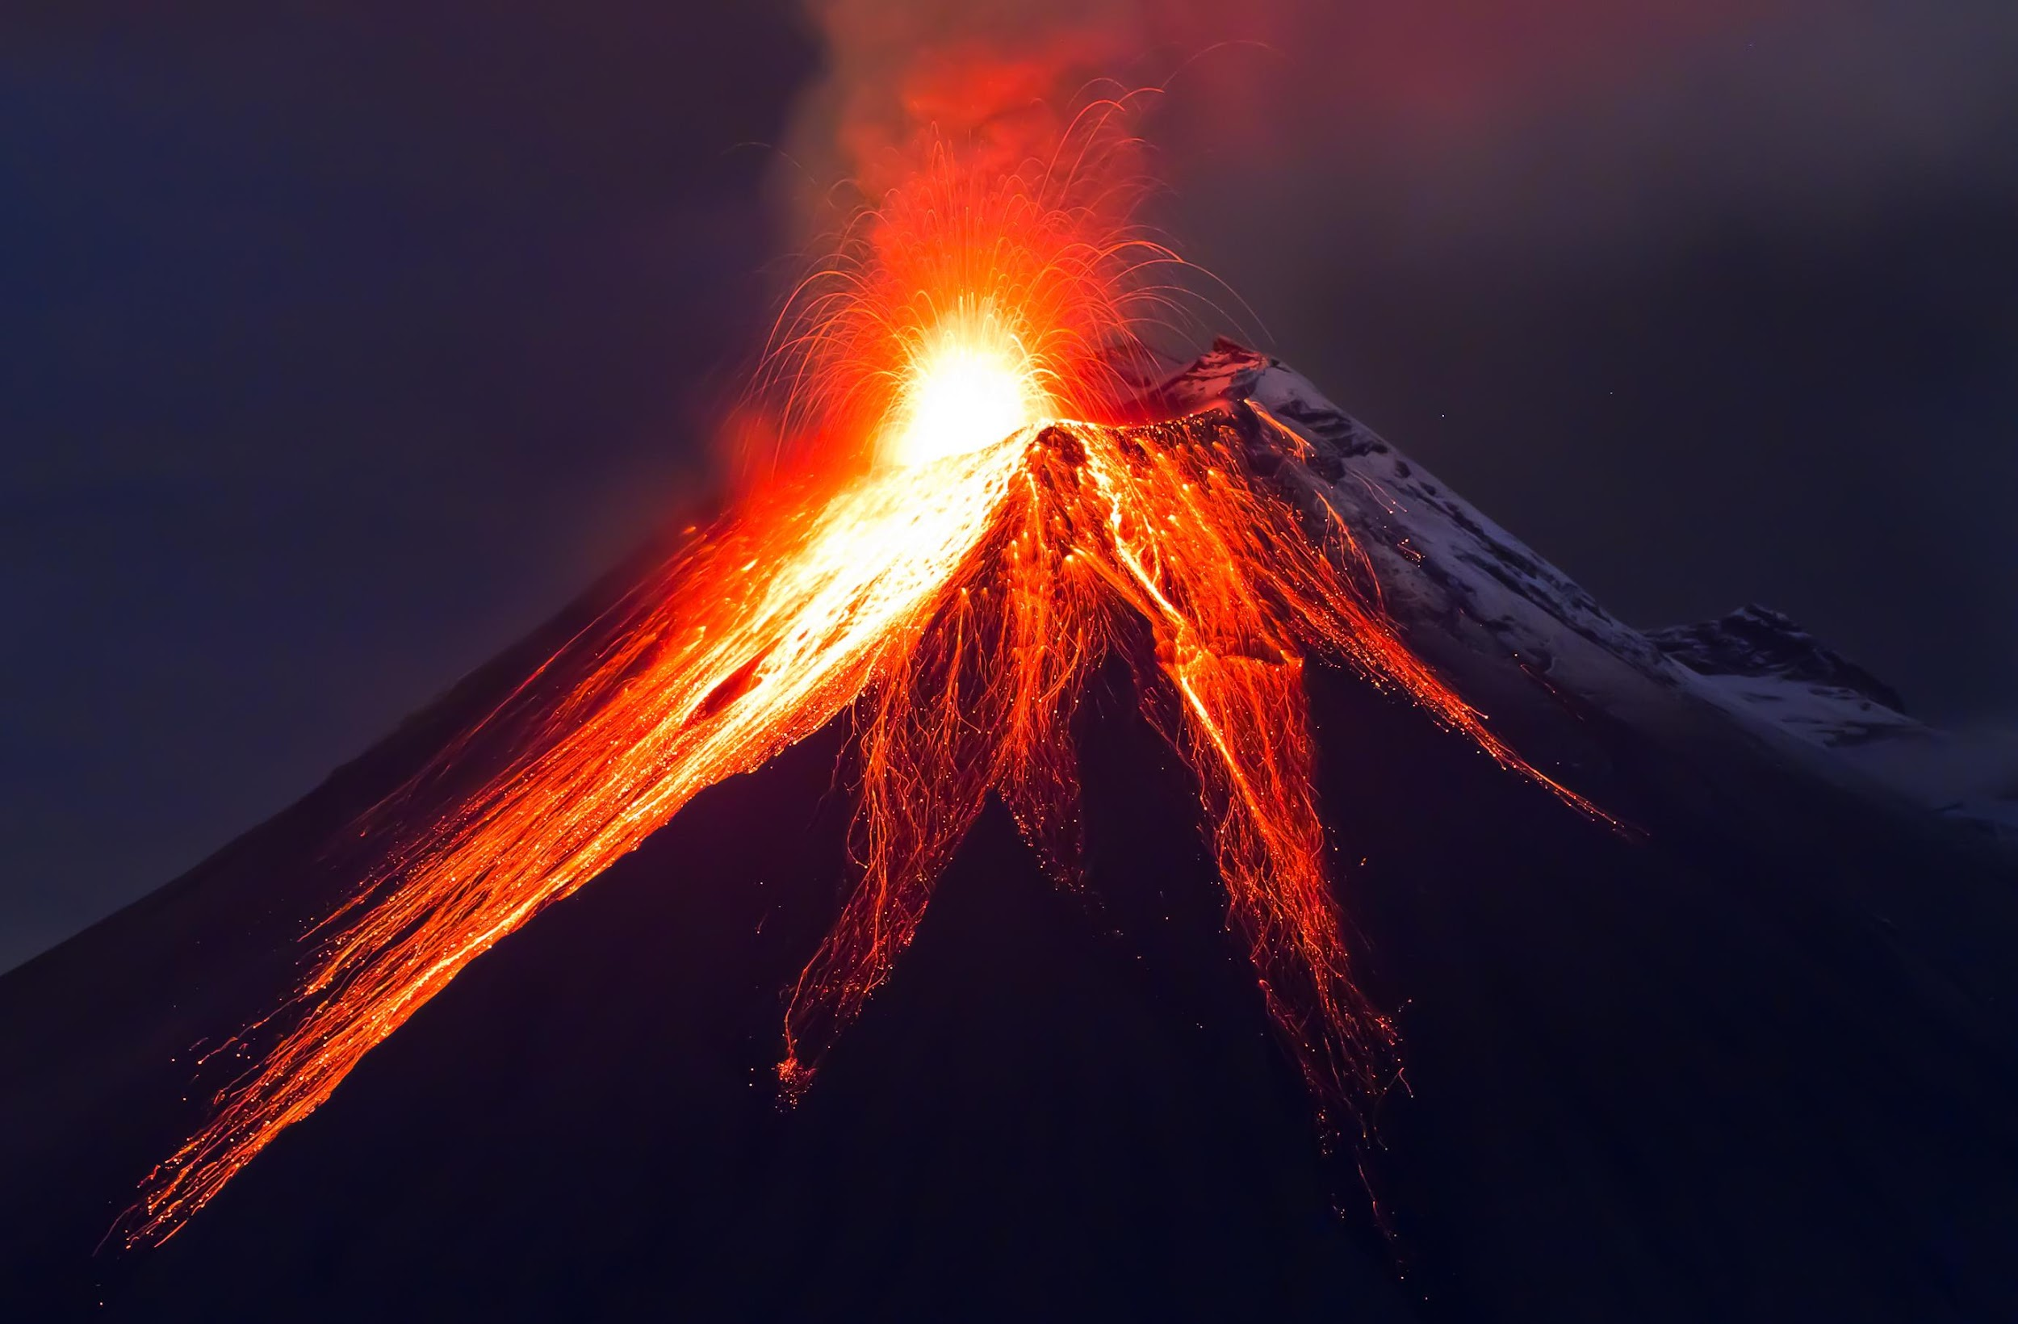
Look at the Code and Demonstration?
drive/My Drive/ComputerVision/Final Project/Image/Volcano.jpg

